Slide 1
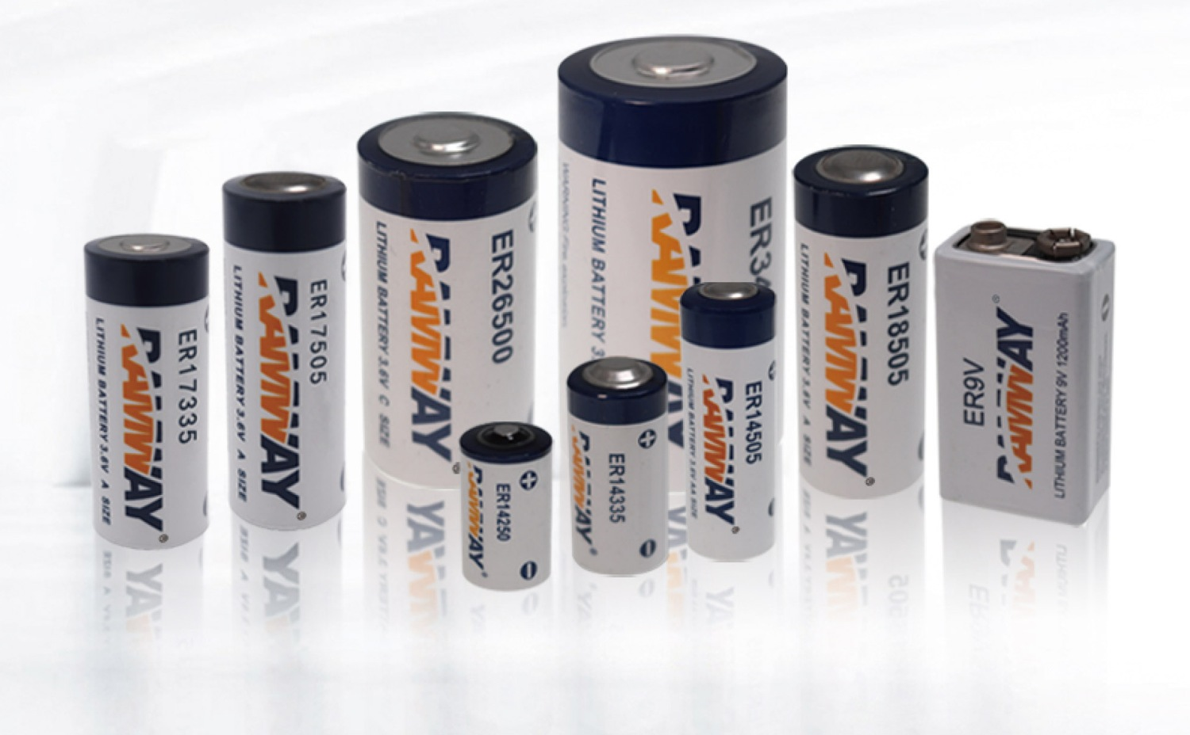
SUIDIAN
BATTERY CUSTOMIZATION / SUIDIAN
10 years of
battery expertise
Better value.
Faster assembly.
RAMWAY supplier cell range
2023 catalog / PDF p.4
Cell supply & custom battery assembly
COMPANY & PRODUCT GUIDE
Guangzhou Suidian Electrical Equipment Co., Ltd.*
October 2026 / English edition
*Working English company name, pending confirmation
Supplier image: RAMWAY 2023, PDF p.4 / Review draft
01 / 08
Notes:
Supplier image: RAMWAY 2023, PDF p.4
Source product images: local RAMWAY 2023 catalog or company WeChat reference, as labelled. Company details, product availability and usage rights require confirmation. No new performance, certification or authorization claim is made.
Commercial strengths supplied by the user on 2026-10-17: 10 years of industry technical experience in battery customization, high cost-effectiveness and fast processing. Ten years refers to technical experience, not the company incorporation date. No fixed lead time or price reduction is asserted.

Slide 2
WHY SUIDIAN / OUR STRENGTHS
Experience. Value. Speed.
Ten years of hands-on battery customization experience, competitive pricing and fast assembly for your device projects.
10 years of expertise
Practical battery customization know-how, from cell selection to leads, connectors and device-specific assembly.
Cost-effective solutions
Competitive pricing for cell supply and custom assemblies. Match the configuration to the job and make your budget work harder.
Fast assembly turnaround
Responsive customization and fast assembly to keep your project moving. Lead times are confirmed for each configuration and quantity.
广州穗电电气设备有限公司
Cell distribution, custom assembly and resale / Alibaba: gzsddq.m.en.alibaba.com
Battery customization expertise / Final specification, quotation and delivery schedule by agreement.
Suidian / Battery customization, cell supply and assembly / Review draft
02 / 08
Notes:
Suidian / Battery customization, cell supply and assembly
Source product images: local RAMWAY 2023 catalog or company WeChat reference, as labelled. Company details, product availability and usage rights require confirmation. No new performance, certification or authorization claim is made.
User-confirmed commercial strengths: 10 years of battery customization technical experience, high cost-effectiveness and fast processing. This is not an independent audit or a claim about incorporation date.

Slide 3
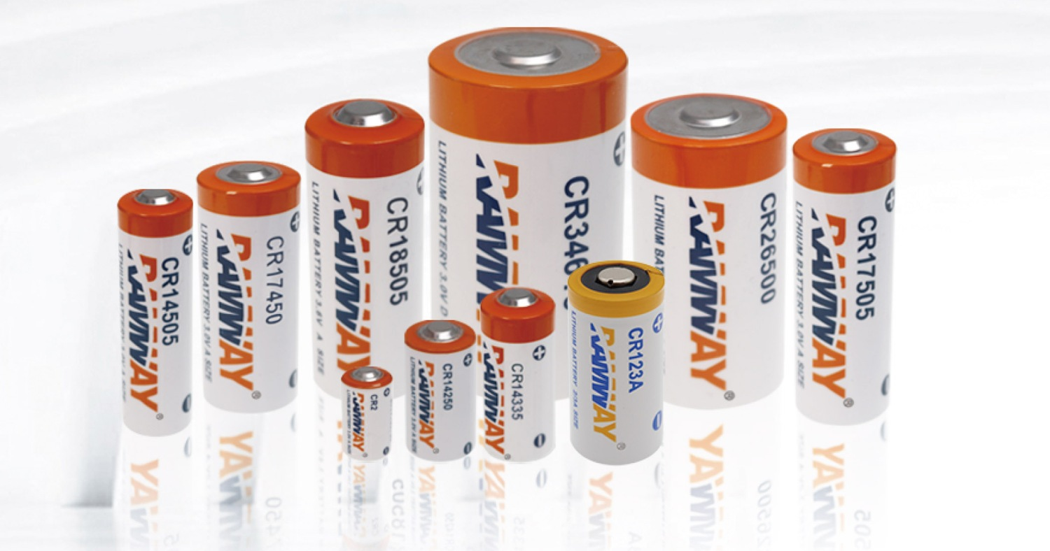
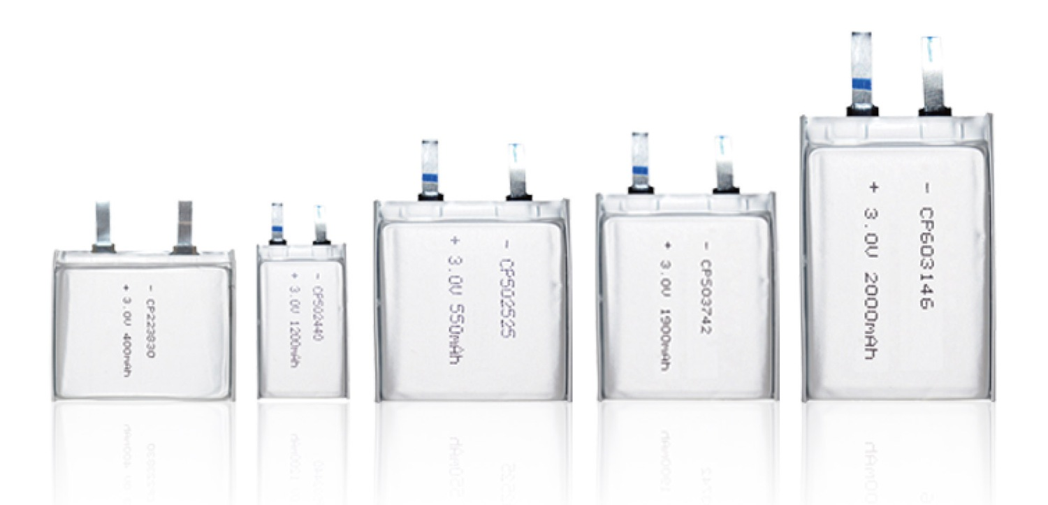
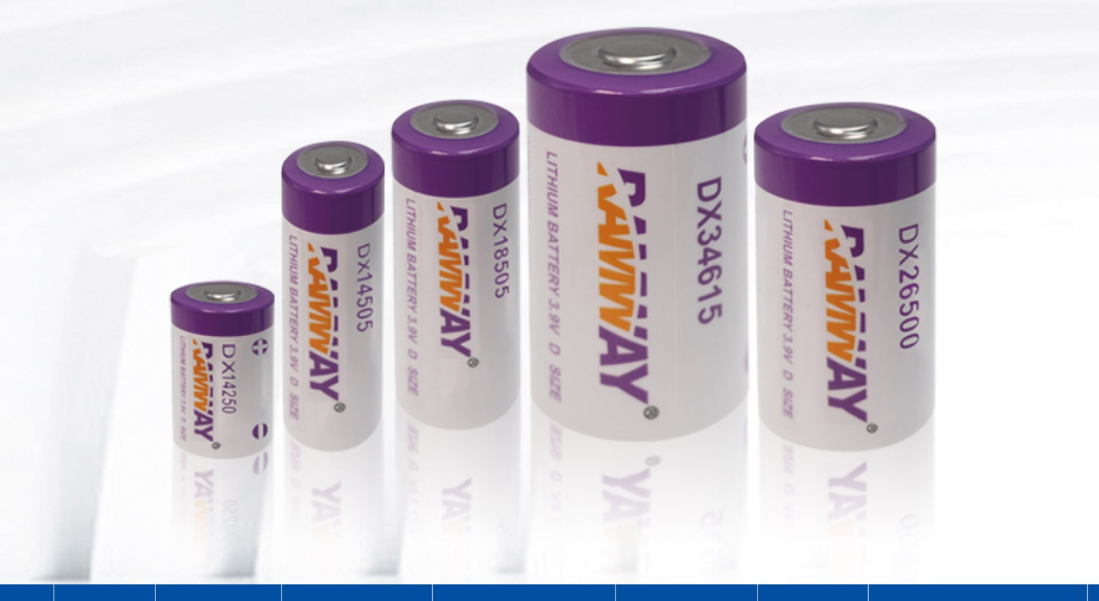
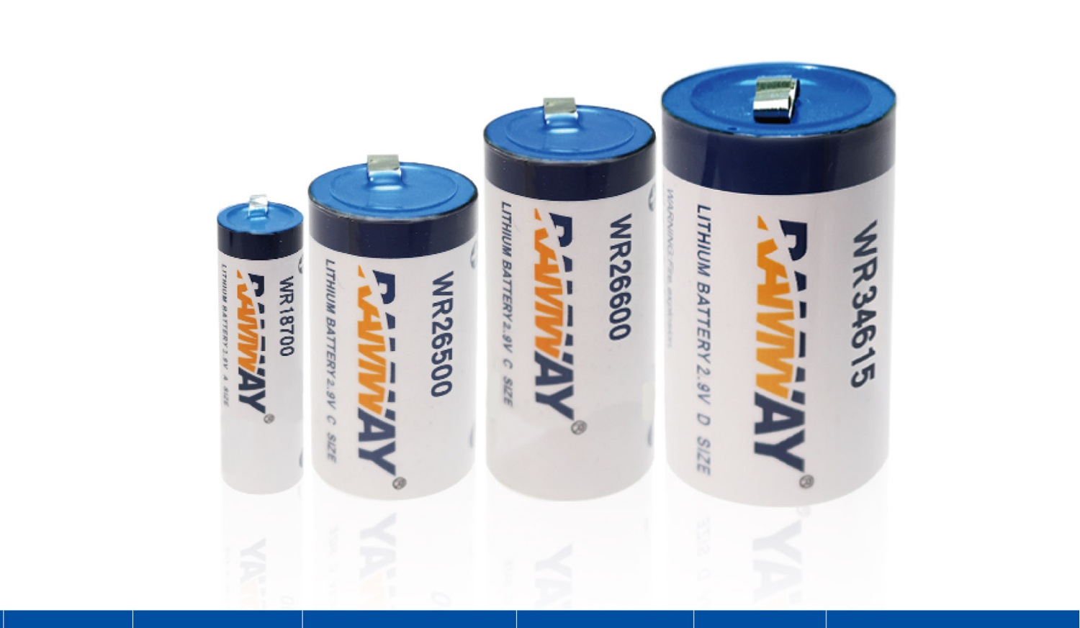
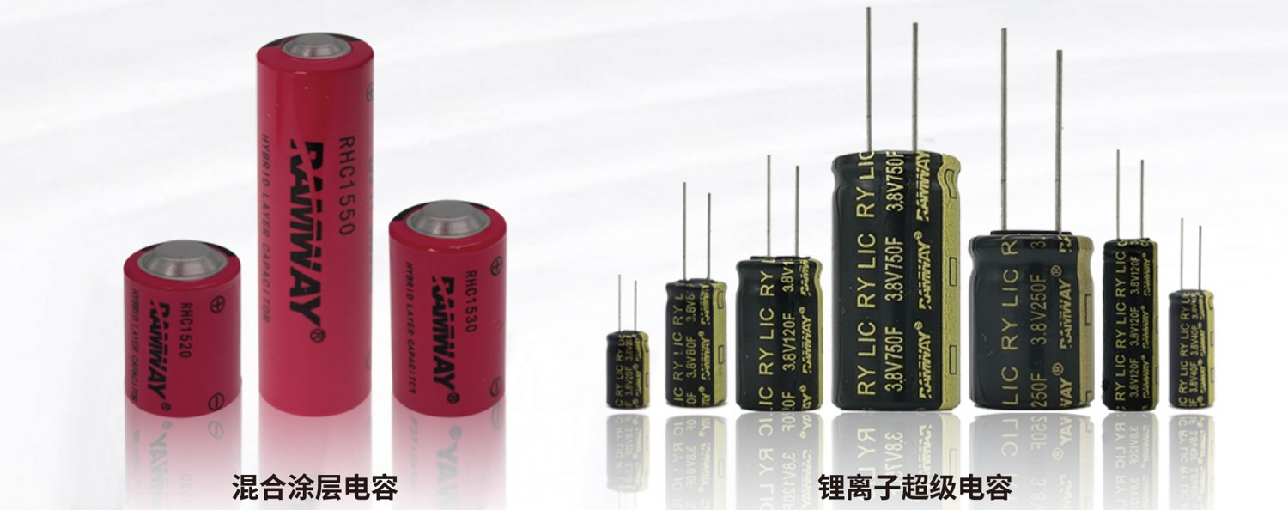
PRODUCT FAMILIES / RAMWAY
The supplier product range
Six catalog families provide a starting point for selection. Current availability and product specifications require confirmation.
ER SERIES
CR SERIES
CP SERIES
Li-SOCl₂ cells
Li-MnO₂ cylindrical cells
Li-MnO₂ thin cells
RAMWAY / PDF p.4
RAMWAY / PDF p.5
RAMWAY / PDF p.5
DX SERIES
WR SERIES
RHC / RY LIC
Li-SO₂Cl₂ cells
Li-SO₂ cells
Hybrid & lithium-ion capacitors
RAMWAY / PDF p.6
RAMWAY / PDF p.6
RAMWAY / PDF p.7
RAMWAY 2023 catalog, physical PDF pp.4-7 / Review draft
03 / 08
Notes:
RAMWAY 2023 catalog, physical PDF pp.4-7
Source product images: local RAMWAY 2023 catalog or company WeChat reference, as labelled. Company details, product availability and usage rights require confirmation. No new performance, certification or authorization claim is made.

Slide 4
MODEL REFERENCES / SELECTION
Five model references
Values transcribed from the 2023 supplier catalog. Confirm test conditions, the latest datasheet and final configuration before selection.
Model | Chemistry | Voltage | Capacity | Maximum size | Source
ER14505 | Li-SOCl₂ | 3.6 V | 2,700 mAh | Ø14.5 × 50.5 mm | PDF p.4
ER26500 | Li-SOCl₂ | 3.6 V | 9,000 mAh | Ø26.2 × 50.0 mm | PDF p.4
ER34615 | Li-SOCl₂ | 3.6 V | 19,000 mAh | Ø34.0 × 61.5 mm | PDF p.4
CR123A | Li-MnO₂ | 3.0 V | 1,600 mAh | Ø17.0 × 34.5 mm | PDF p.5
CP502440 | Li-MnO₂ | 3.0 V | 1,200 mAh | 41 × 25 × 5.2 mm | PDF p.5
Load profile
Environment
Integration
Average current, pulse peak,
duration and cut-off voltage.
Operating and storage
temperatures, life target.
Space, connector, polarity
and sample test plan.
RAMWAY 2023 catalog, PDF pp.4-5 / Reference data, not a performance guarantee / Review draft
04 / 08
Notes:
RAMWAY 2023 catalog, PDF pp.4-5 / Reference data, not a performance guarantee
Source product images: local RAMWAY 2023 catalog or company WeChat reference, as labelled. Company details, product availability and usage rights require confirmation. No new performance, certification or authorization claim is made.

Slide 5
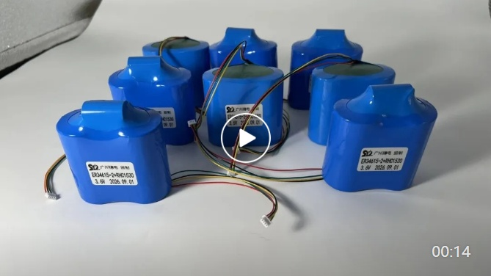
SUIDIAN / ASSEMBLY
The interface to your device
A clear device brief connects the electrical load to the physical assembly.
Electrical
Voltage, average current,
pulse peak and cut-off voltage.
Mechanical
Cell layout, dimensions, lead
length, connector and polarity.
Validation
Drawing approval, test conditions
and sample acceptance criteria.
Static image from the company video
Suidian WeChat reference. Cell configuration and ratings
cannot be verified from the thumbnail alone.
Discuss the actual process scope before quoting.
Company WeChat screenshot and user-described assembly business / Review draft
05 / 08
Notes:
Company WeChat screenshot and user-described assembly business
Source product images: local RAMWAY 2023 catalog or company WeChat reference, as labelled. Company details, product availability and usage rights require confirmation. No new performance, certification or authorization claim is made.

Slide 6
APPLICATION REQUIREMENTS
Selection starts with the duty cycle
Use the application to frame the requirements. Device compatibility and operating life require evaluation of the actual equipment.
Water & gas metering
Transmission interval and pulse load
Operating temperature and life target
IoT & wireless sensors
Communication load and enclosure space
Connector, mounting and environmental limits
Industrial equipment backup
Exact equipment and original battery
Voltage, connector, polarity and replacement plan
Application examples are not Suidian customer cases or compatibility guarantees.
Company WeChat profile and supplier application references / Review draft
06 / 08
Notes:
Company WeChat profile and supplier application references
Source product images: local RAMWAY 2023 catalog or company WeChat reference, as labelled. Company details, product availability and usage rights require confirmation. No new performance, certification or authorization claim is made.

Slide 7
PRODUCT DOCUMENTATION
Evidence for the
exact configuration
Match the documents to the model, assembly and intended shipment.
CELL
ASSEMBLY
SHIPMENT
Current model data
Configuration approval
Applicable documents
Datasheet and revision
Test conditions and curves
Dimensions and supplier identification
Approved drawing
Sample results and acceptance criteria
Batch identification
Safety and transport files
Final configuration coverage
Packaging requirements
Document request checklist. Company certification, shipment eligibility and market approval are not claimed in this draft.
Document scope and validity require verification / Review draft
07 / 08
Notes:
Document scope and validity require verification
Source product images: local RAMWAY 2023 catalog or company WeChat reference, as labelled. Company details, product availability and usage rights require confirmation. No new performance, certification or authorization claim is made.

Slide 8
NEXT PROJECT / TECHNICAL INQUIRY
Your device requirements
A useful inquiry includes the application, electrical load, physical interface and expected quantity.
Application
Device model and operating environment
SUIDIAN
广州穗电电气设备有限公司
Electrical
Voltage, average current and pulse profile
Guangzhou Suidian Electrical
Equipment Co., Ltd.*
Integration
Dimensions, connector drawing and polarity
Export email, phone and official
website to be supplied.
Order planning
Samples, annual demand and destination
*Working English name, pending confirmation.
Contact information and public use require approval.
The website preview prepares a local inquiry file. No inquiry is sent to a server.
Company details and publication permissions pending confirmation / Review draft
08 / 08
Notes:
Company details and publication permissions pending confirmation
Source product images: local RAMWAY 2023 catalog or company WeChat reference, as labelled. Company details, product availability and usage rights require confirmation. No new performance, certification or authorization claim is made.

